Slide 1
On Queries to the Root
Geoff Huston & George Michaelson
research@apnic.net

Slide 2
The story so far…
There have been a number of studies of the queries seen at the root
  DNS OARC Workshops
  Name Collision Workshop, March 14
A number of desktop studies of the query behaviour of certain OS / Browser combinations when they perform name resolution (e.g. ICANN SECSAC report)
But the two classes of studies are looking at each “end”
How do they relate to each other?
  How is local end system name resolution behaviour reflected as queries at the root?

Slide 3
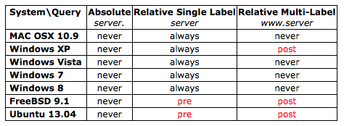
OS System Library Behaviour
How do local search lists interact with user-provided names when performing name resolution when using the OS system library for name resolution?
never: the local search list is not used
always: the local search list is always appended to the name
pre: the local search list is appended, if NXDOMAIN, then the name is queried
post: the name is queried, if NXDOMAIN then the search list is appended
http://www.potaroo.net/ispcol/2013-10/dotless.html

Slide 4
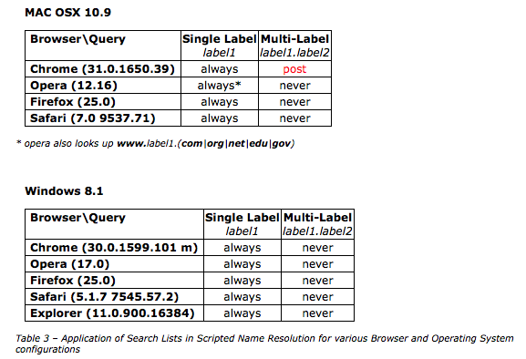
OS + Browser Behaviour
http://www.potaroo.net/ispcol/2013-10/dotless.html

Slide 5
Can we…
Set up an experimental framework where the identity of the user’s browser and OS can be linked to query behaviour as seen by the DNS root servers?

Slide 6
This Experiment
Used Google’s AD network to deliver a volume of end user tests, timed to coincide with the DNS OARC “Day In The Life” (DITL) data collection of queries made to root zone servers
The embedded code used 4 URL elements:
  URL with a single label (unique) name
  URL with a two label (unique name)
  URL to the experiment server
  (10 second wait)
  URL to the experiment server

Slide 7
Experiment Statistics
The Ad campaign was active from the 15th April to the 17th April 2014
  5,302,927 instances of the ad were seen to make HTTP queries to the experiment’s servers

Slide 8
Root Queries
We used the DNS OARC DITL collection of logs of queries at root servers, and looked for queries that were the result of our experiment
  Logs were available for A, C, E, F, H, I, J, K, M roots
    No logs from L ☹
  11,177,623 DNS queries for the experiment’s identifying string were found in the DITL log files
  6,771,931 unique experiments made DNS queries that were seen at a root server

Slide 9
The Experiment
Two URLs were passed to the user’s browser upon impression of the ad that are of interest with respect to root server queries
  A single DNS label
    http://<locate-string>-<unique-label>-single-label-name/index.html
  A 2-label name
    http://second-label.<locate-string>-<unique-label>-single-label-name/index.html

Slide 10
The Theory (1)
The single label name:
  If there is a local search string defined then this string will be appended to the label and the DNS query is formed
  If the search string is a defined name then the name servers for the name should be cached, and the query should not appear at the root
  If there is no local search string then the name should be queried, but as this is a unique name, it is not cache, so the query should be visible to the root servers (*)
The 2-label name:
  The name should not have any search string appended
  As the name is unique, the name should be the subject of a query to the root servers (*)

Slide 11
The Theory (2)
The root server query logs should contain some single label queries (presumably where there are no locally defined search strings)
A comprehensive root server query log collection should contain all 2 label name queries (*)

Slide 12
(*) Well… not quite “all”
A number of recursive DNS resolvers (including Google’s PDNS) maintain a local copy of the signed root zone, and are able to respond to incoming queries from their local root zone without passing the query to a root server

Slide 13
The Practice
The DITL root logs are incomplete
  Not all root servers
  Not all anycast instances
Not all resolvers forward all queries relating to non-cached names to a root server

Slide 14
Some results
Experiments seen at the root and seen at the server: 3,326,162
Most of these align with theory
  i.e. we see the two-label name queries at the root, but not the single label name
46.185.98.0 Mozilla/5.0 (Windows NT 6.1; WOW64) AppleWebKit/537.36 (KHTML, like Gecko) Chrome/34.0.1847.116 Safari/537.36
k A second-label.q1w2e3r46t-10002ee-single-label-name.
61.28.160.0 Mozilla/5.0 (Windows NT 6.1) AppleWebKit/537.36 (KHTML, like Gecko) Chrome/34.0.1847.116 Safari/537.36
i A second-label.q1w2e3r46t-100031e-single-label-name.
37.244.130.0 Mozilla/5.0 (Windows NT 5.1) AppleWebKit/537.36 (KHTML, like Gecko) Chrome/34.0.1847.116 Safari/537.36
j A second-label.q1w2e3r46t-1000344-single-label-name.

Slide 15
Collected Data Set
End Client Public IP address
End Client OS and Browser signature (User Agent String)
The DNS resolver used by the End Client (at the end of any forwarder chain)
The Root server
The Root server anycast instance
The query type
The query string
Time

Slide 16
Results (2)
However, some 539,445 experiments do not precisely align with this theory
Single Label names are meant to have the local search string appended before querying the DNS
Mostly this search string means that the resultant name is resolved without recourse to querying the root
But sometimes these queries leak …

Slide 17
Local Search Strings
12,101 unique local search strings were seen
Top 25:
home. 55,997
homestation. 20,861
belkin. 6,168
lan. 5,047
dlink. 3,690
localdomain. 3,427
arris. 3,200
hitronhub.home. 3,148
domain. 2,347
local. 2,258
asus. 2,082
local.lan. 1,719
router. 1,029
co.yu. 869
fcname. 773
homerouter.cpe. 719
yu. 602
home.network. 518
private. 517
org.home. 466
gateway. 461
tendaap. 450
enhwi-n3. 439
wimax. 434
mynet. 429
btc-adsl. 422

Slide 18
Where’s “.corp”?
estudiodemoda.corp. 15
corp.int-ads. 13
eua.bvcorp.corp. 12
personal.corp. 11
global.ecolab.corp. 11
corp.local. 10
corp.pri. 9
ncs.corp.int-ads. 9
parcorretora.corp. 9
bvcorp.corp. 8
corona.corp. 8
res.hu.corp. 7
ihs.internal.corp. 7
lat.corp. 7
porta.corp. 7
iusacell.corp. 6
corp.oprema.local. 6
corp.vrx. 6
corp. 6
corp.internal. 6
casetek.corp.pegatron. 6
heathco.corp. 5
farous.corp. 5
realogy.corp.rlg. 4
twn.rexchip.corp. 4
quanta.corp. 4
laz.bvcorp.corp. 4
centralcervejas.corp. 4
amer.zurich.corp. 4
.corp as a single label search string suffix is not widely used
But <name>.corp and corp.<name> are used, which makes this look like a widely used alternate coordinated name space, although this could easily be an outcome of local config recipes instead of a shadow tld

Slide 19
And where’s “.local”?
local. 2,258
local.lan. 1,719
sarmientoba.local. 219
local.tld. 89
domain.local. 52
dmu.local. 36
champestate.local. 32
buttcon.local. 31
lufrance.local. 29
dialok.local. 28
es.gov.br.local. 25
org.local. 21
riops.local. 20
cameiap.local. 19
metabenessere.local. 16
spec.local. 14
vescon.local. 14
gov.br.local. 14
tapdoanbaominh.local. 13
phlaurent.local. 13
net.local. 13
kld.local. 13
lutacom.local. 13
com.local. 11
local.larandia. 11
hattrick.local. 11
v6-632.local. 11
telecomitalia.local. 10
mifi.local. 10
dominio.local. 10
Much the same as .corp, in that there is widespread use of <name>.local and local.<name>
A similar picture is seen for “localdomain”

Slide 20
Name prepending…
pmpzajgi8cz9g.second-label.q1w2e3r46t-3c108cb618c058c0-single-label-name.
ze3gv3ye31jzq.second-label.q1w2e3r46t-3c109cb614af8b70-single-label-name.
u0p5rqvnaktql.second-label.q1w2e3r46t-3c10bcb614af8b70-single-label-name.
gcz616z-7ey6f.second-label.q1w2e3r46t-3c11fcb614afb280-single-label-name.
gq10xgmassppn.second-label.q1w2e3r46t-3c122cb614afb280-single-label-name.
d459jc760yb0k.second-label.q1w2e3r46t-3c122cb614afb280-single-label-name.
ym1apqonty69d.second-label.q1w2e3r46t-3c122cb614afb280-single-label-name.
sbyet9x3ttv3l.second-label.q1w2e3r46t-3c123cb614afb280-single-label-name.
uo396n6z46irq.second-label.q1w2e3r46t-3c125cb61acc2e50-single-label-name.
zm9a340nbe57l.second-label.q1w2e3r46t-3c12ccb61acc2e50-single-label-name.
okik8a7kqsfkj.second-label.q1w2e3r46t-3c132cb614afd990-single-label-name.
b70x6przr6gjo.second-label.q1w2e3r46t-3c135cb61acc5560-single-label-name.
b1py34eppcjsk.second-label.q1w2e3r46t-3c139cb61acc5560-single-label-name.
vmekjb648b5af.second-label.q1w2e3r46t-3c13ccb61acc5560-single-label-name.
b7q-ok2v6t2ol.second-label.q1w2e3r46t-3c140cb618c0cdf0-single-label-name.
yfvoss0eti1nk.second-label.q1w2e3r46t-3c143cb614afd990-single-label-name.
gybst9bkv9jap.second-label.q1w2e3r46t-3c143cb61acc5560-single-label-name.
ei3zq73xp8n7l.second-label.q1w2e3r46t-3c144cb614afd990-single-label-name.
kj7v0-j51ssbp.second-label.q1w2e3r46t-3c147cb618c0cdf0-single-label-name.
i77xgr83qbfpj.second-label.q1w2e3r46t-3c151cb614b000a0-single-label-name.
ig7fai29iitzn.second-label.q1w2e3r46t-3c152cb61acc7c70-single-label-name.
y77440po1p55d.second-label.q1w2e3r46t-3c15bcb614b000a0-single-label-name.
u3e0tz6jm0qri.second-label.q1w2e3r46t-3c160cb614b000a0-single-label-name.
h9fvkqnnj82il.second-label.q1w2e3r46t-3c161cb614b000a0-single-label-name.
k55k239xcig8m.second-label.q1w2e3r46t-3c164cb614b000a0-single-label-name.
v-9qgckt3qbzk.second-label.q1w2e3r46t-3c164cb61acca380-single-label-name.
m9tza3s7qmv7g.second-label.q1w2e3r46t-3c16acb614b000a0-single-label-name.
There are 322,490 instances of this, and there is no clear 1:1 association with a particular browser – is this some kind of DNS recursive resolver behaviour performing a form of wild card detection?

Slide 21
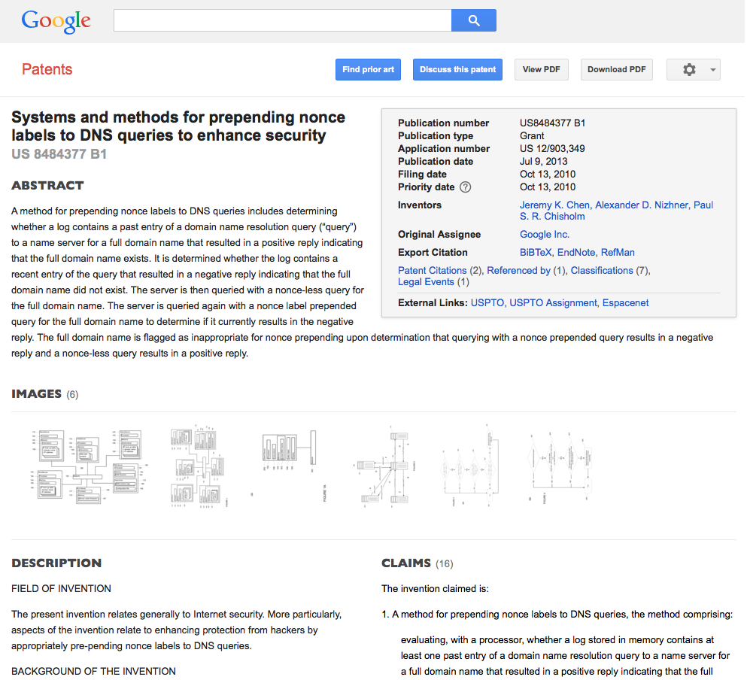
Name Prepending

Slide 22
Search Lists
The .corp result is interesting:
  Its not that large numbers of local DNS name resolvers add “.corp” to local DNS names prior to resolution
  It’s a little more subtle than that, and we see a significant set of instances where the local search string is a multi-label name that includes the label “corp”
Out of 12,101 unique search strings seen, 1,654 used 2 or more labels

Slide 23
Local Search Lists and new TLDs
How many names from the set of new gTLDs are seen in these local search lists?
Out of 1,299 names: (http://icannwiki.com/index.php/All_New_gTLD_Applications)
  121 names were seen in search strings
  64,158 experiments used search strings containing applied names (out of 160,688 experiments that generated search string queries at a root)

Slide 24
aaa 2
abc 1
acer 1
ads 12
airtel 1
amp 1
apple 1
art 1
asda 1
band 1
bank 1
bet 1
bingo 1
book 3
bosch 1
box 3
business 7
cam 1
casa 2
cba 1
center 2
cisco 4
clubmed 1
computer 1
corp 246
dell 1
dev 9
dhl 1
digital 1
dot 1
earth 1
ecom 2
exchange 1
fiat 1
fido 1
fox 1
garden 1
global 14
gold 3
google 1
group 16
health 1
here 1
home 105
hospital 1
host 4
hot 1
hotel 3
hotels 1
house 1
hsbc 9
hughes 1
ice 4
idn 1
iinet 2
imdb 1
inc 7
ing 1
kia 1
law 1
link 1
live 1
loan 1
lol 1
mail 2
matrix 1
mcd 1
med 3
microsoft 1
mma 1
mnet 4
mobile 1
moscow 1
movistar 2
msd 1
mtr 1
natura 1
network 9
new 1
nico 1
office 6
one 1
orange 8
pccw 1
prod 7
radio 1
ram 1
realty 1
safe 1
samsung 1
sarl 1
sbi 5
school 1
seven 1
sew 2
sfr 1
site 12
sky 1
sony 1
spa 2
sport 1
star 5
starhub 1
stc 2
svr 1
tata 1
team 1
telefonica 2
thai 1
tirol 1
top 2
toshiba 1
toyota 1
unicorn 1
web 2
win 5
windows 1
work 1
world 3
wow 1
youtube 1
Seen names and the search string occurrence as seen in this experiment

Slide 25
Further Work
Mapping users to root name server instances
Measuring the “transparency” of undelegated gTLDs
Number of root queries per trigger instance
Consistency between predicted Browser/OS behavious and observed behaviours

Slide 26
Thanks
To Google for sponsoring our costs in the advertisement campaign used to generate the original use data for this analysis

